Slide 1

INSTITUTE OF TECHNOLOGY
X LOCATION
DEPARTMENT OF ELECTRONICS AND COMMUNICATION ENGINEERING
Mini-Project Presentation On
“Brain tumour detection using image processing”
Submitted in Partial Fulfillment of the requirement of Mini Project[18ECMP68]
In
ELECTRONICS AND COMMUNICATION ENGINEERING.
Under the Guidance of:
XXXXXX
Assistant Professor. Dept. of E&C Engg,
MRIT.
Presented by:
Gaurav Kumar [4MU18EC000] XXXXXXXXX XXXXXXXX
7/12/2021
1

Slide 2
CONTENTS
ABSTRACT
INTRODUCTION
OBJECTIVES
METHODOLOGY
SOFTWARE SPECIFICATION
MATLAB CODE
RESULTS AND DISCUSSION
BENEFITS & APPLICATION
CONCLUSION AND FUTURE WORK
REFERENCES
28/07/2021
02

Slide 3
ABSTRACT :
Brain tumour detection and classification is that the most troublesome and tedious task within the space of medicative image getting ready.
Magnetic resonance imaging may be a medicative procedure, typically adopted by the medical specialist for illustration of inner structure of the build with no surgery.
Magnetic resonance imaging provides long information concerning the human delicate tissue, that helps within the conclusion of brain tumour .
Precise segmentation of magnetic resonance imaging, image is basic for the conclusion of brain tumour by laptop supported clinical device.
This project is concentrated towards the look of Associate in Nursing best and additional correct approach for the detection of neoplasm from brain magnetic resonance imaging scans and if it confirms the presence of tumour then it's focused on evaluating its stage, i.e ,malignant.
28/07/2021
03

Slide 4
INTRODUCTION:
This project proposes two different methodologies to segment a tumor from an MRI image and determine the type of tumor. For this one segmentation and one clustering techniques have been implemented.
Each MRI image is passed through an imaging chain where the image preprocessed to remove noise and is further enhanced to improve the contrast of the image.
MRI paper proposes two different techniques which are then applied on the image to extract the tumor.
MRI segmentation techniques include SOM Clustering and SVM Classification.
The tumor region represents the pixel values for the foreground points extracted using the input() command from a texture image. The texture image is generated by applying the rangefilt() method.
28/07/2021
04

Slide 5
CONTi...
Also the unwanted noise and reduced contrast displays several regions from the image that are falsely claimed as a tumor.
Another challenge faced was degraded quality of the MRI image due to several problems that would have occurred during the acquisition stage.
In this project, the major challenge faced was to locate and extract the proper tumor region from the image. Due to several lighting issues, unnecessary white portions were present in the image which could wrongly be segmented as a tumor.
28/07/2021
05

Slide 6
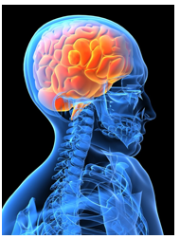
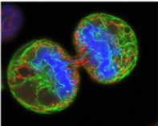
WHAT IS BRAIN TUMOUR?
Uncontrolled and abnormal cell growth in the brain is called a brain tumour. The space in our skull is restricted. Therefore, this extra growth inside our brain causes more pressure inside the skull, causing life-threatening complications, and also damaging our brain.
28/07/2021
06

Slide 7
OBJECTIVES:
The main goal of medical image processing is to Identify accurate and meaningful information using images with the minimum error possible.
MRI images can be processed and the brain tumour can be segmented.
The MRI images are further enhanched using matlab software to get the accurate result of finding the tumour .
28/07/2021
07

Slide 8
PROPOSED METHOD :
In this Proposed Method are classified in 5 parts:
MRI of Brain Images
Pre-Processing
Images Enhancement and Filtering
Feature Extraction
Image Analysis
28/07/2021
08

Slide 9
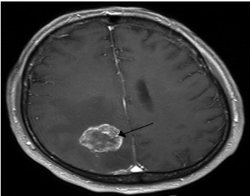
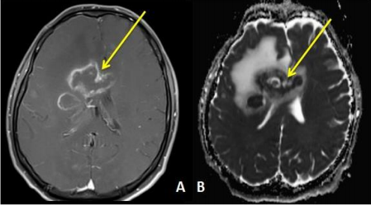
MRI OF BRAIN TUMOUR:
In this the data is been provided that is the magnetic resonance images(MRI) that are been collected in their original format’s that are (.ima, .dcm).
Mostly the MRI images are of .dcm (DICOM[13]) Digital imaging and communications in medicine.
We have used file operations fopen(), fclose() available in matlab to read MRI images. Here the gray scale MRI images are been provided as input to the system
28/07/2021
09

Slide 10
PRE-PROCESSING:
Pre-processing phase of our project mainly involves those operations that are ordinarily essential before the goal analysis and extraction of the required data and ordinarily geometric corrections of the initial image.
This conversion of DICOM image to .jpeg is done by using function dicom2image()[7]. Major issues related to the preprocessing stage are as follows:-
Noise,
Blur Low Contrast
The bias
The partial-volume effect.
28/07/2021
10

Slide 11
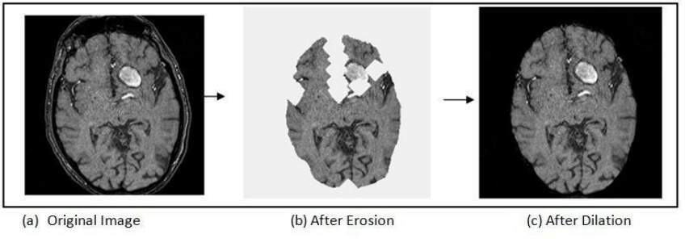
CONTi...
This pre-processing stage is used for reducing image noise, highlighting important portions, or displaying obvious portions of digital images.
28/07/2021
11

Slide 12
IMAGE ENCHAMENT & FILTERING:
The enhancement of the image starts by first converting the gray scale image to black and white image this is done by the use of function im2bw(gray_image)[7].
As Image improvement strategies improve the visual look of pictures from tomography and also the distinction enhancing brain volumes are linearly associated.
For image sharpening the imsharpen()[7] is been used, similarly imadjust()[7] for image adjustment, freqz() for setting frequency response of image are been used.
The Gaussian smoothing operator is been for the two dimensional image convolution operators that is used to `blur' images and remove detail and noise
The colour spaces used in our image processing methods are Gray, Binary form and RGB.
28/07/2021
12

Slide 13
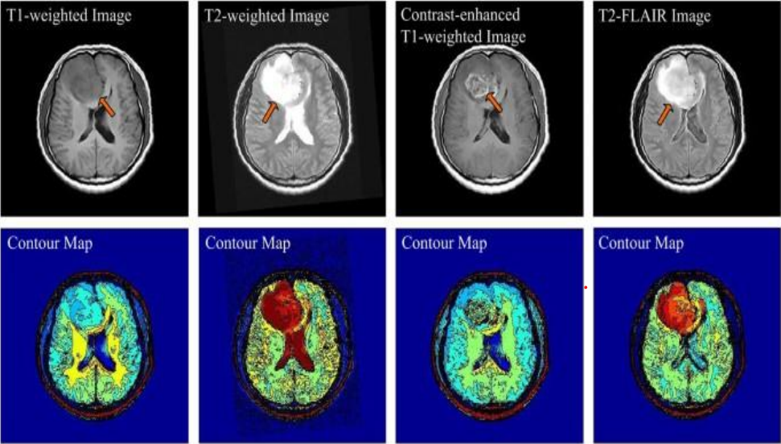
CONTi...
Color areas, which indicate the colors in an exceedingly benchmark approach by employing a reference frame and a topological space within which every color is delineated by one point of the coordinate system.
28/07/2021
13

Slide 14
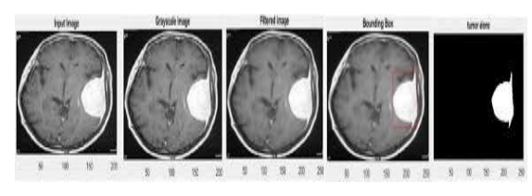
FEATURE EXTRACTION:
In this phase the features of the given input image is been extracted .
These features include smoothness, entropy, variance, kutosis, skewness, idm, correlation, homogeneity, mean and standard deviation .
And on the basis of these features the image is analysed and the detection of the tumor region is been done.
Below in the figure there are output result of an MRI image uptill the feature extraction phase of the project.
(a)Input image, (b)Grayscale image, (c)Tumor alone image, (d)Tumor outline, (e)Detected tumor
28/07/2021
14

Slide 15
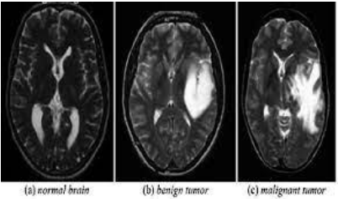
IMAGE ANALYSIS:
After the type of tumor is been identified the image analysis is been done to determine the accuracy of the result.
Here in this project four type of accuracy are been shown that are Rbf accuracy, Linear accuracy, Polygonal accuracy and Quadratic accuracy.
These accuracies help in analysis of the image result.
Showing the result of the taken mri image and providing the classification of the type of tumor.
28/07/2021
15

Slide 16
SOFTWARE SPECIFICATION:
SOFTWARE : MATLAB
Version : 21a
MATLAB provide by company math works works is a programming environment used for performing mathematical computation , programming and visualization.
It is a powerful tool that includes its own high-level language and functions for performing math-related tasks faster.
28/07/2021
16

Slide 17
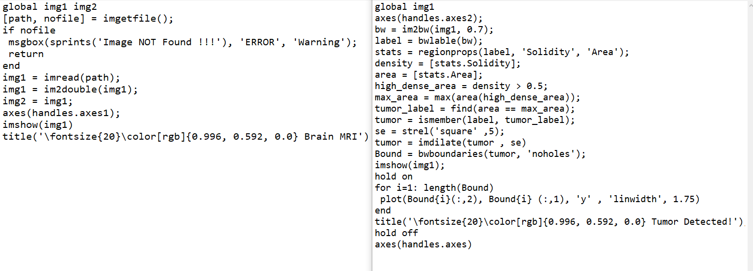
MATLAB CODE:
28/07/2021
17

Slide 18
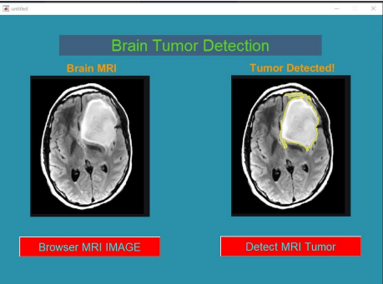
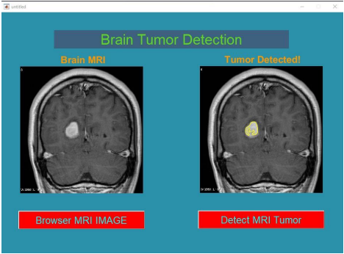
RESULT & DISCUSSION:
28/07/2021
18

Slide 19
BENEFITS:
The main goal of medical image processing is to identify accurate and meaningful information using images with the minimum error possible.
MRI is mainly used to get images of the human body and cancerous tissues because of its high resolution and better quality images compared with other imaging technologies.
28/07/2021
19

Slide 20
APPLICATIONS:
Biomedical Image processing is a growing and demanding field.
It comprises of many different types of imaging methods likes CT scans,X-Ray and MRI.
These techniques allow us to identify even the smallest abnormalities in the human body
MATLAB has image and data processing capabilities, so can be used for analysis of medical imaging data, such as in nuclear medicine, CT, MRI and fluorescein angiogram images. UoB researchers have also used image analysis on microscope and other types of images to detect disease such as brain tumour cancer & etc…
28/07/2021
20

Slide 21
CONCLUSION & FUTURE WORK:
In this project we have automated the diagnosis procedure for the brain tumour detection by the use of image processing.
Apart from several existing brain tumour segmentation and detection methodology are present for MRI of brain image our project has proved to provide an over all accuracy up to 90%.
All the steps for detecting brain tumour that have been discussed starting from MRI image acquisition.
Pre-processing involves operations like proposed based methods has been discussed.
Quality enhancement and filtering are important because edge sharpening, enhancement, noise removal and undesirable background removal are improved the image quality as well as the detection procedure.
After the image quality improvement and noise reduction discussed here, segmentation methodology for a brain tumour from MRI of brain image is been used.
28/07/2021
21

Slide 22
REFERENCES
MathWorks(https://in.mathworks.com/help/wavelet/ug/lifting-method-for-constructing-wavelets.html).
Amrutha Ravi, “Medical Image Segmentation”, Computer Methods And Programs In Biomedicine 84 (2006) 63–65.
Brain Tumor Detection using Wavelet Based Image Fusion
Youtube : https://www.youtube.com/watch?v=tCUkyoDR5t0
Sijbers J et al (1998), “Estimation of the noise in magnitude MR images”, Magn Reson Imaging 16(1):87–90.
An S, An D (1984) Stochastic relaxation, Gibbs distributions, and the Bayesian restoration of images. IEEE Trans Pattern Anal Mach Intell 6:721–741
Nowak RD (1999) Wavelet-based Rician noise removal for magnetic resonance imaging. IEEE Trans Image Process 8(10):1408–1419.
28/07/2021
22

Slide 23
Conti…
Swapnil R.Telrandhe,”segmentation methods for medical image analysis”,tesis no 1434,center for medical image science and visualization ,se-58185 linkoping ,Sweden.
Malathi Hong-Long , , “Segmentation C- Means Clustering With Spatial Information For Image Segmentation,” Computerized Medical Imaging And Graphics 30 (2006) 9–15.
Rajeshwari G tayade,Michel Crucian , “Unsupervised And Semi-Supervised Clustering: A Brief Survey,” Inria Rocquencourt, B.P. 105 78153 Le Chesnay Cedex, France.
Lukas L. et Al. Brain Tumor Classification Based On Long Echo Proton Mrs Signals.
28/07/2021
23

